Slide 1
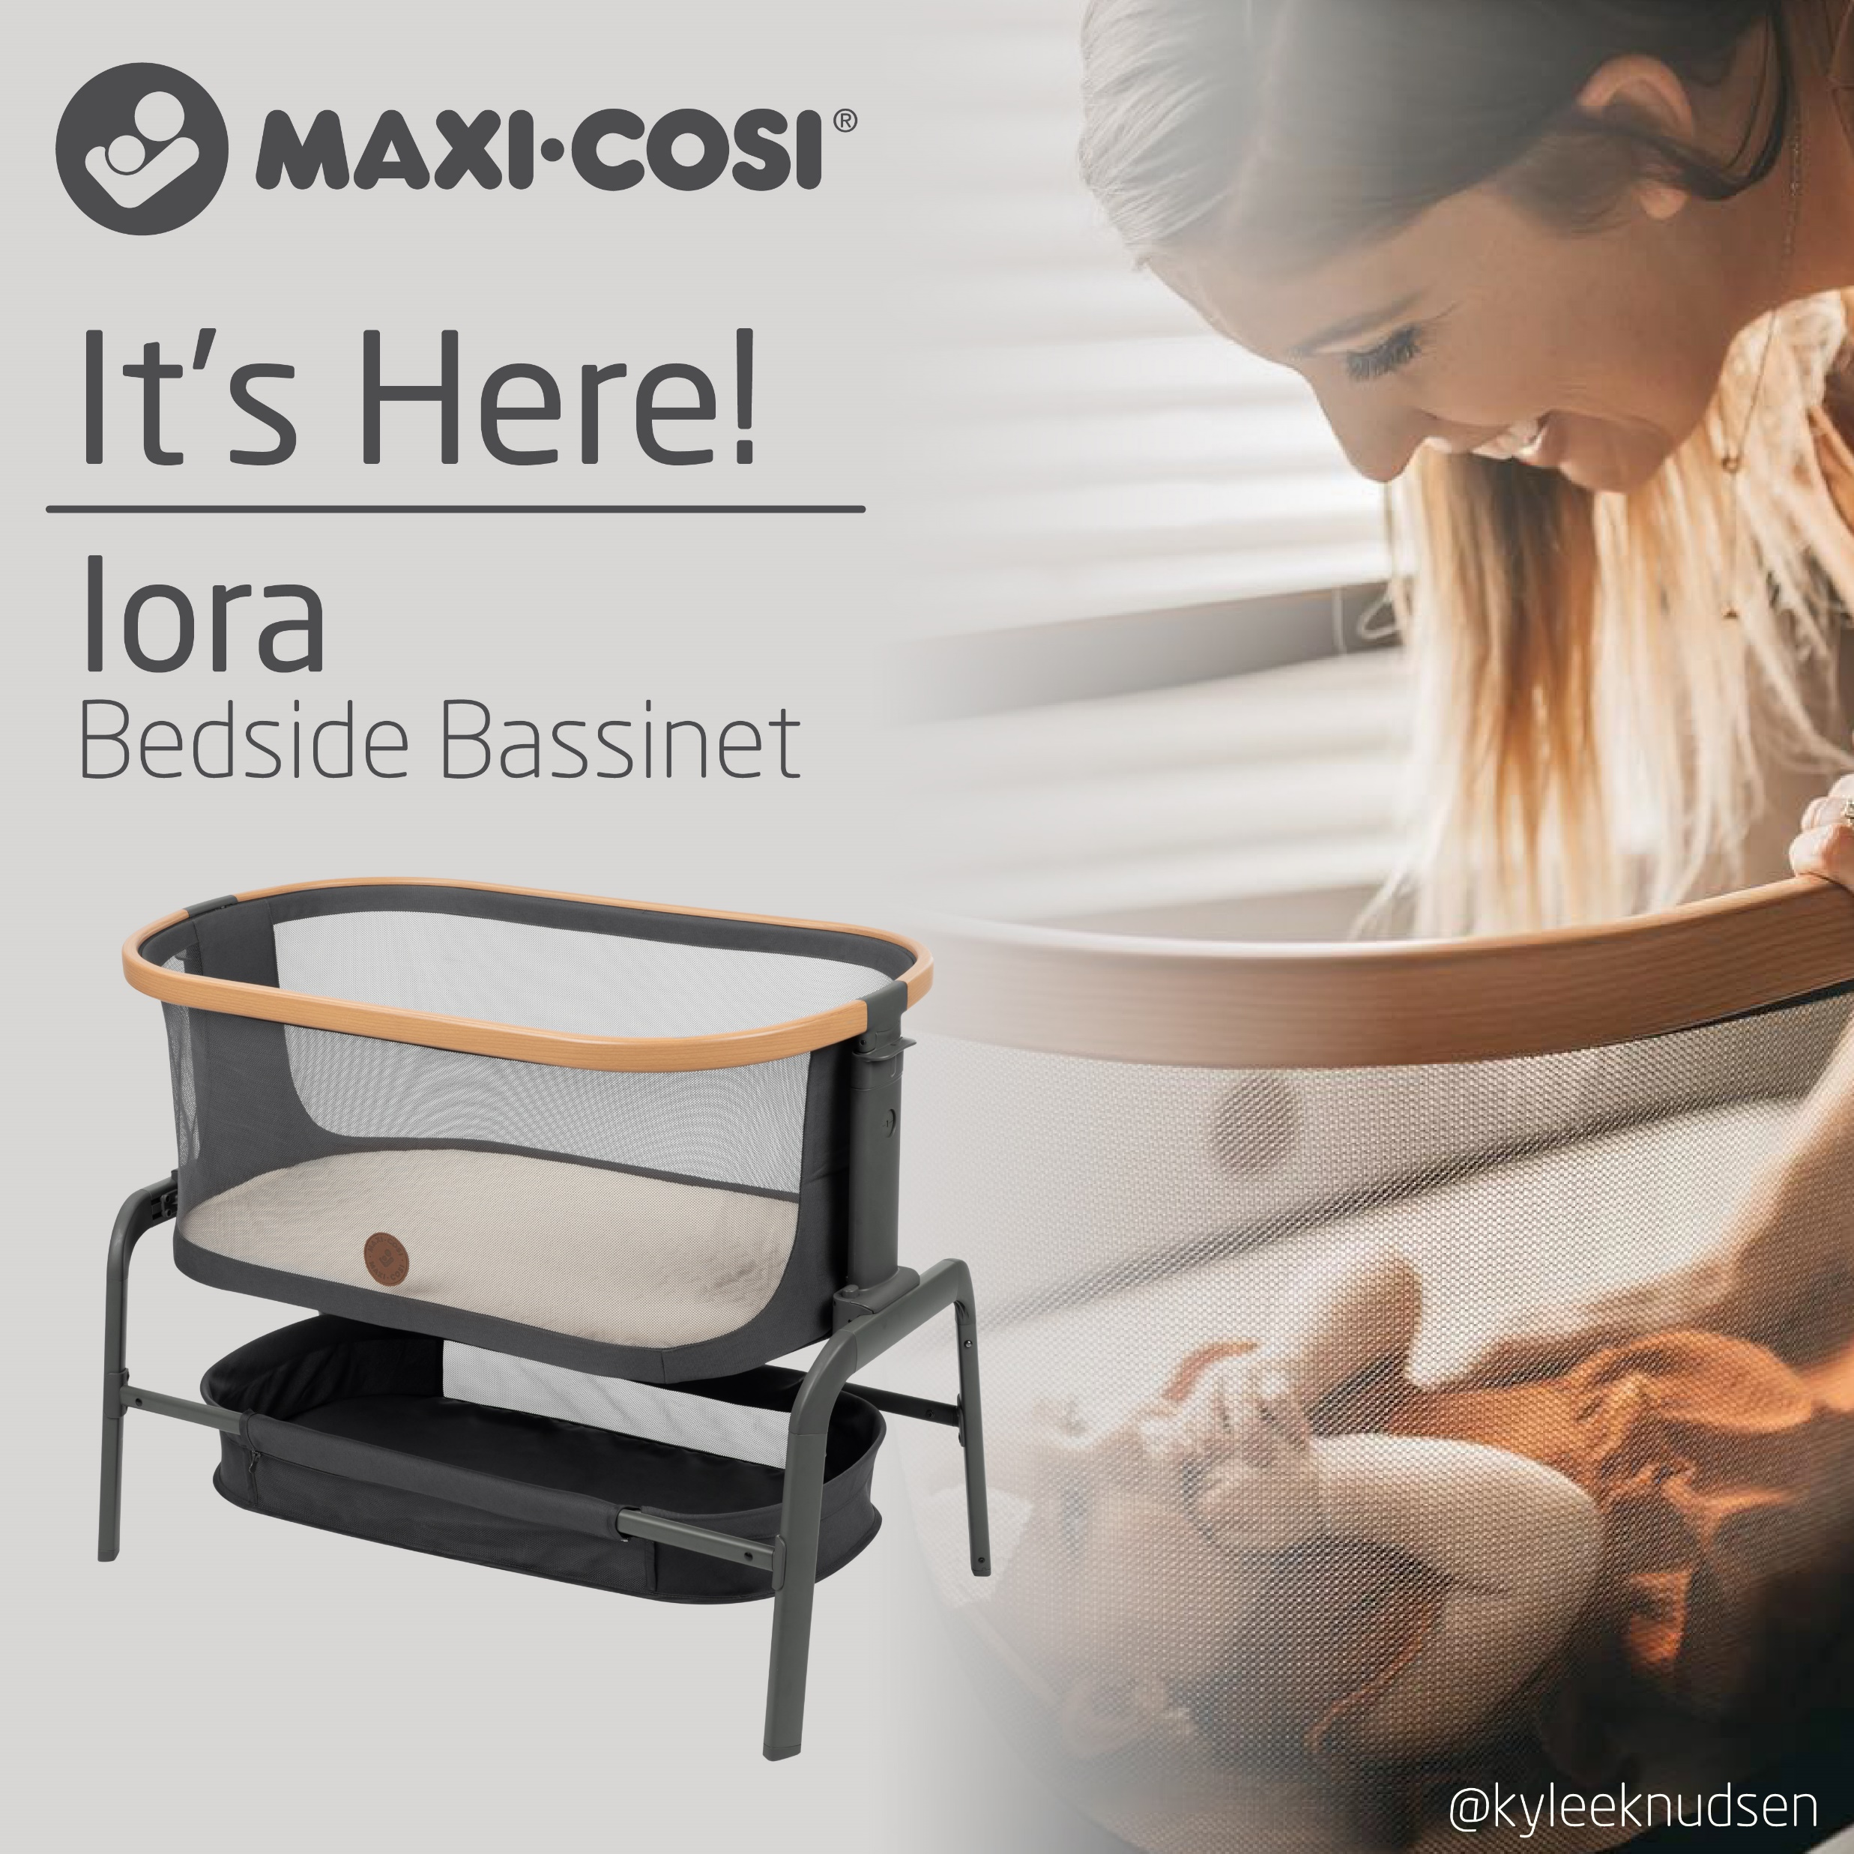
Social post
We are thrilled to announce the arrival of the Maxi Cosi Iora Bedside Bassinet! While we can’t guarantee your child will sleep entirely through the night, we will say that during those restful hours, or sometimes minutes, your little one will be comfy and cozy 📷: @kyleeknudsen

Slide 2
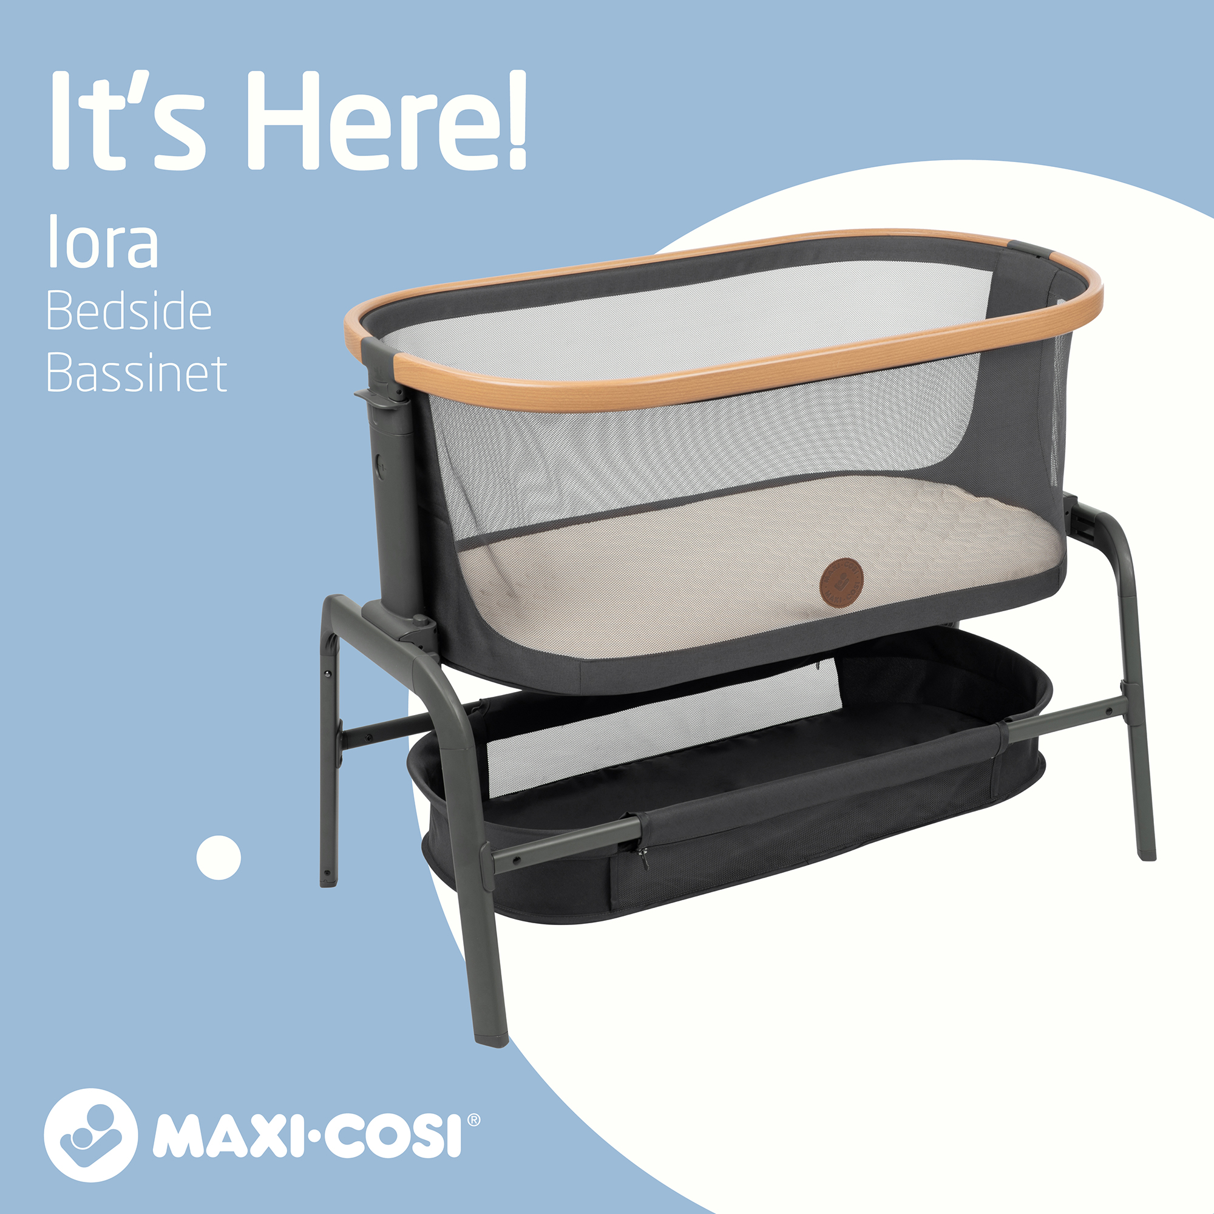
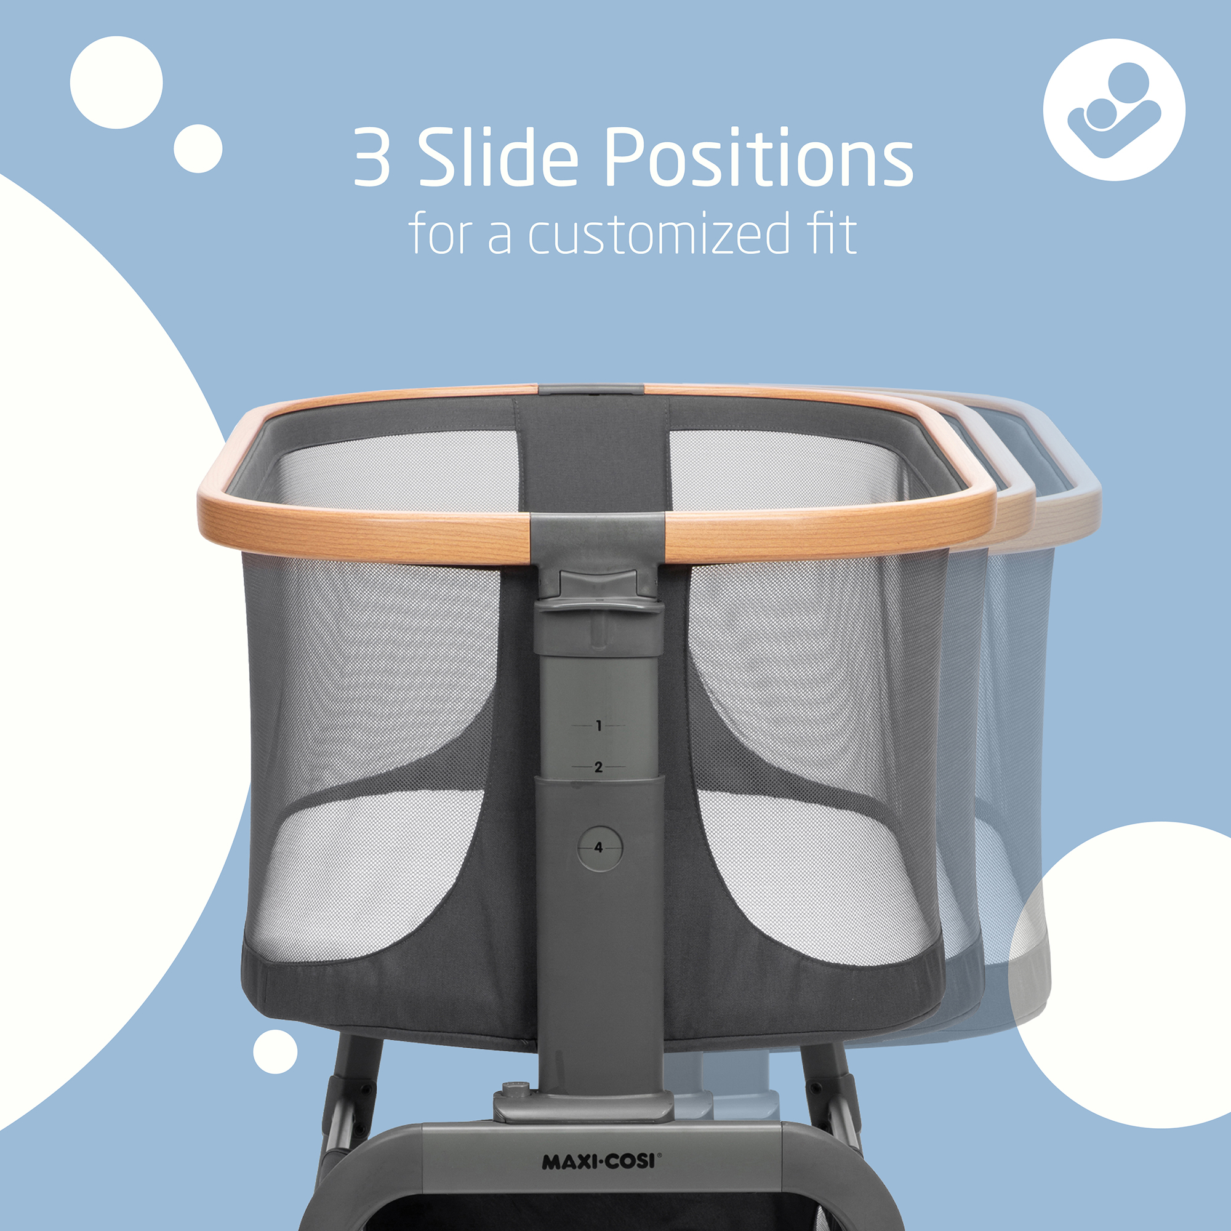
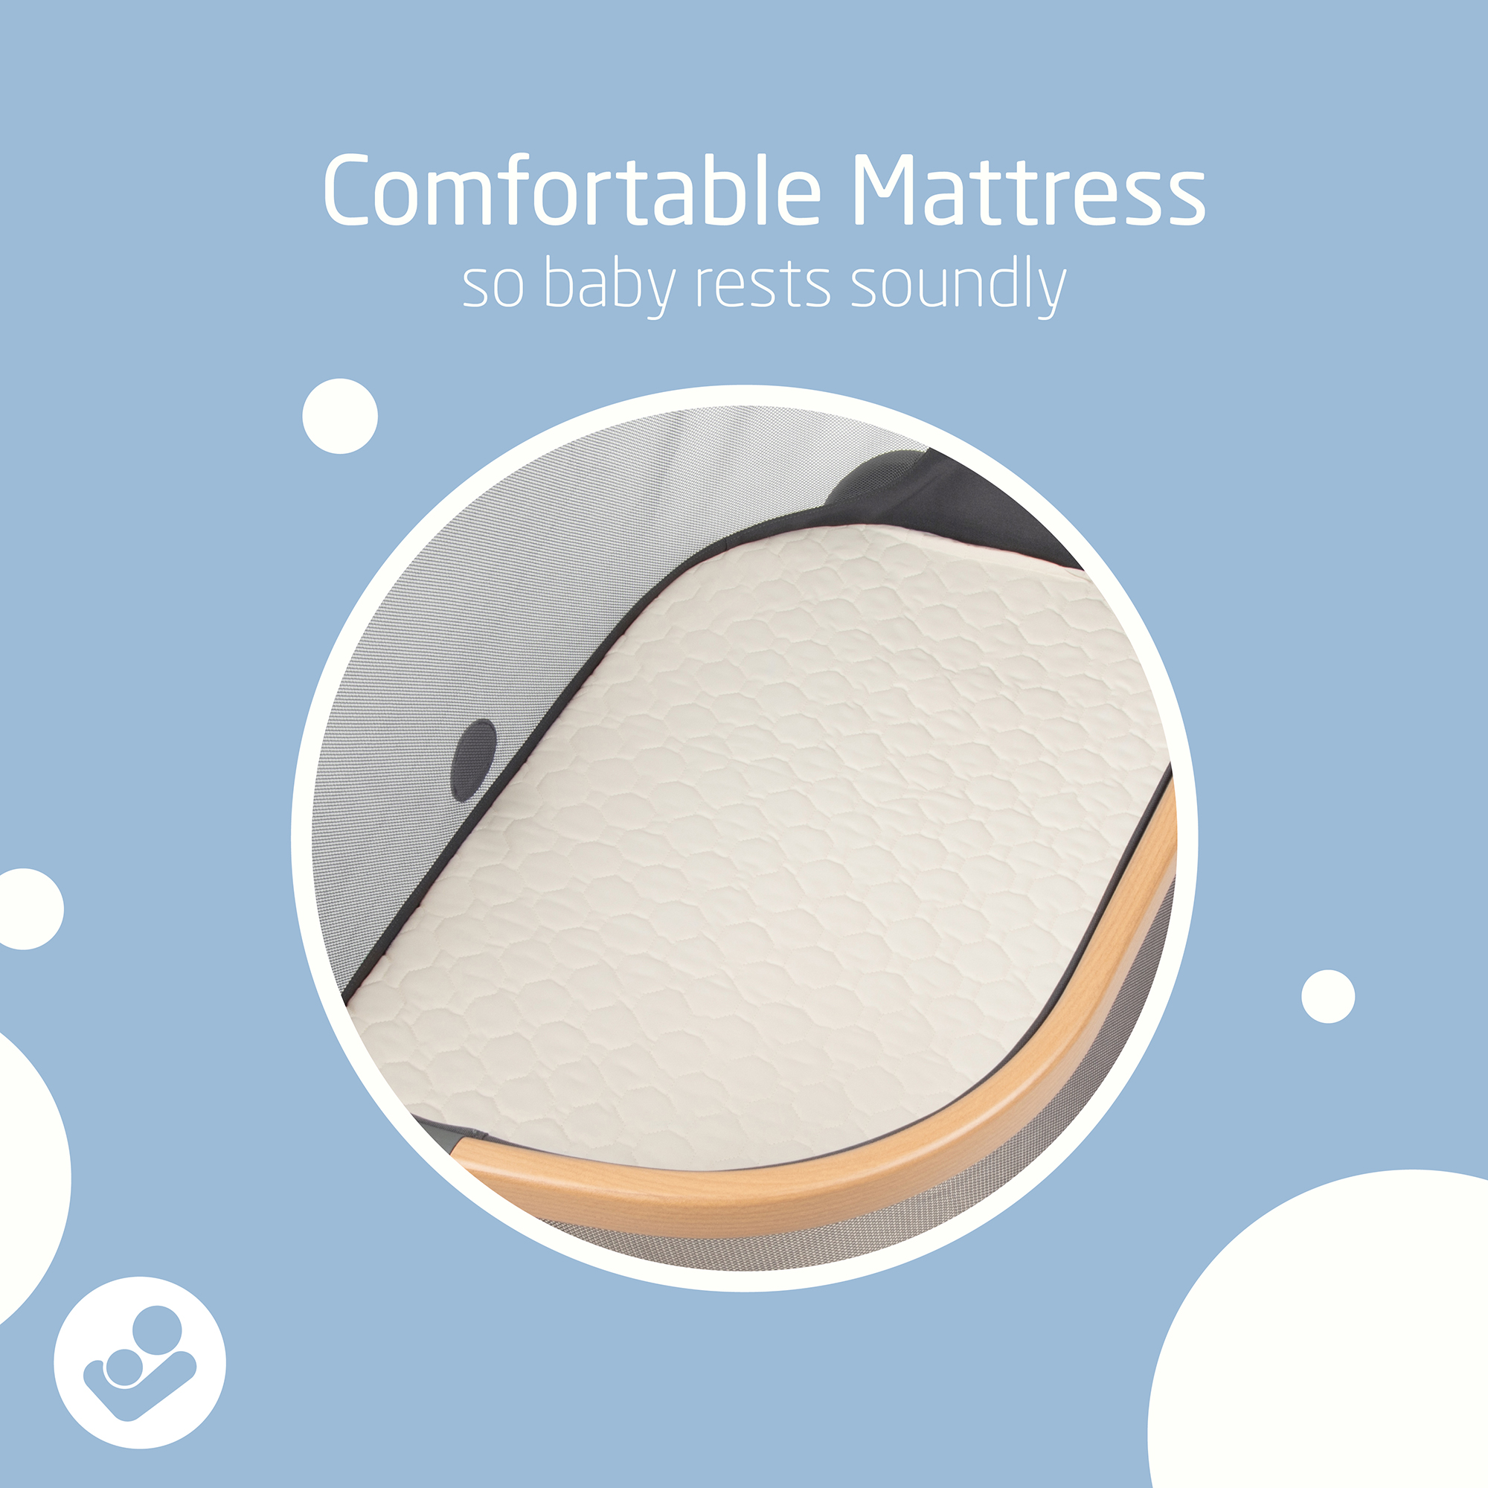
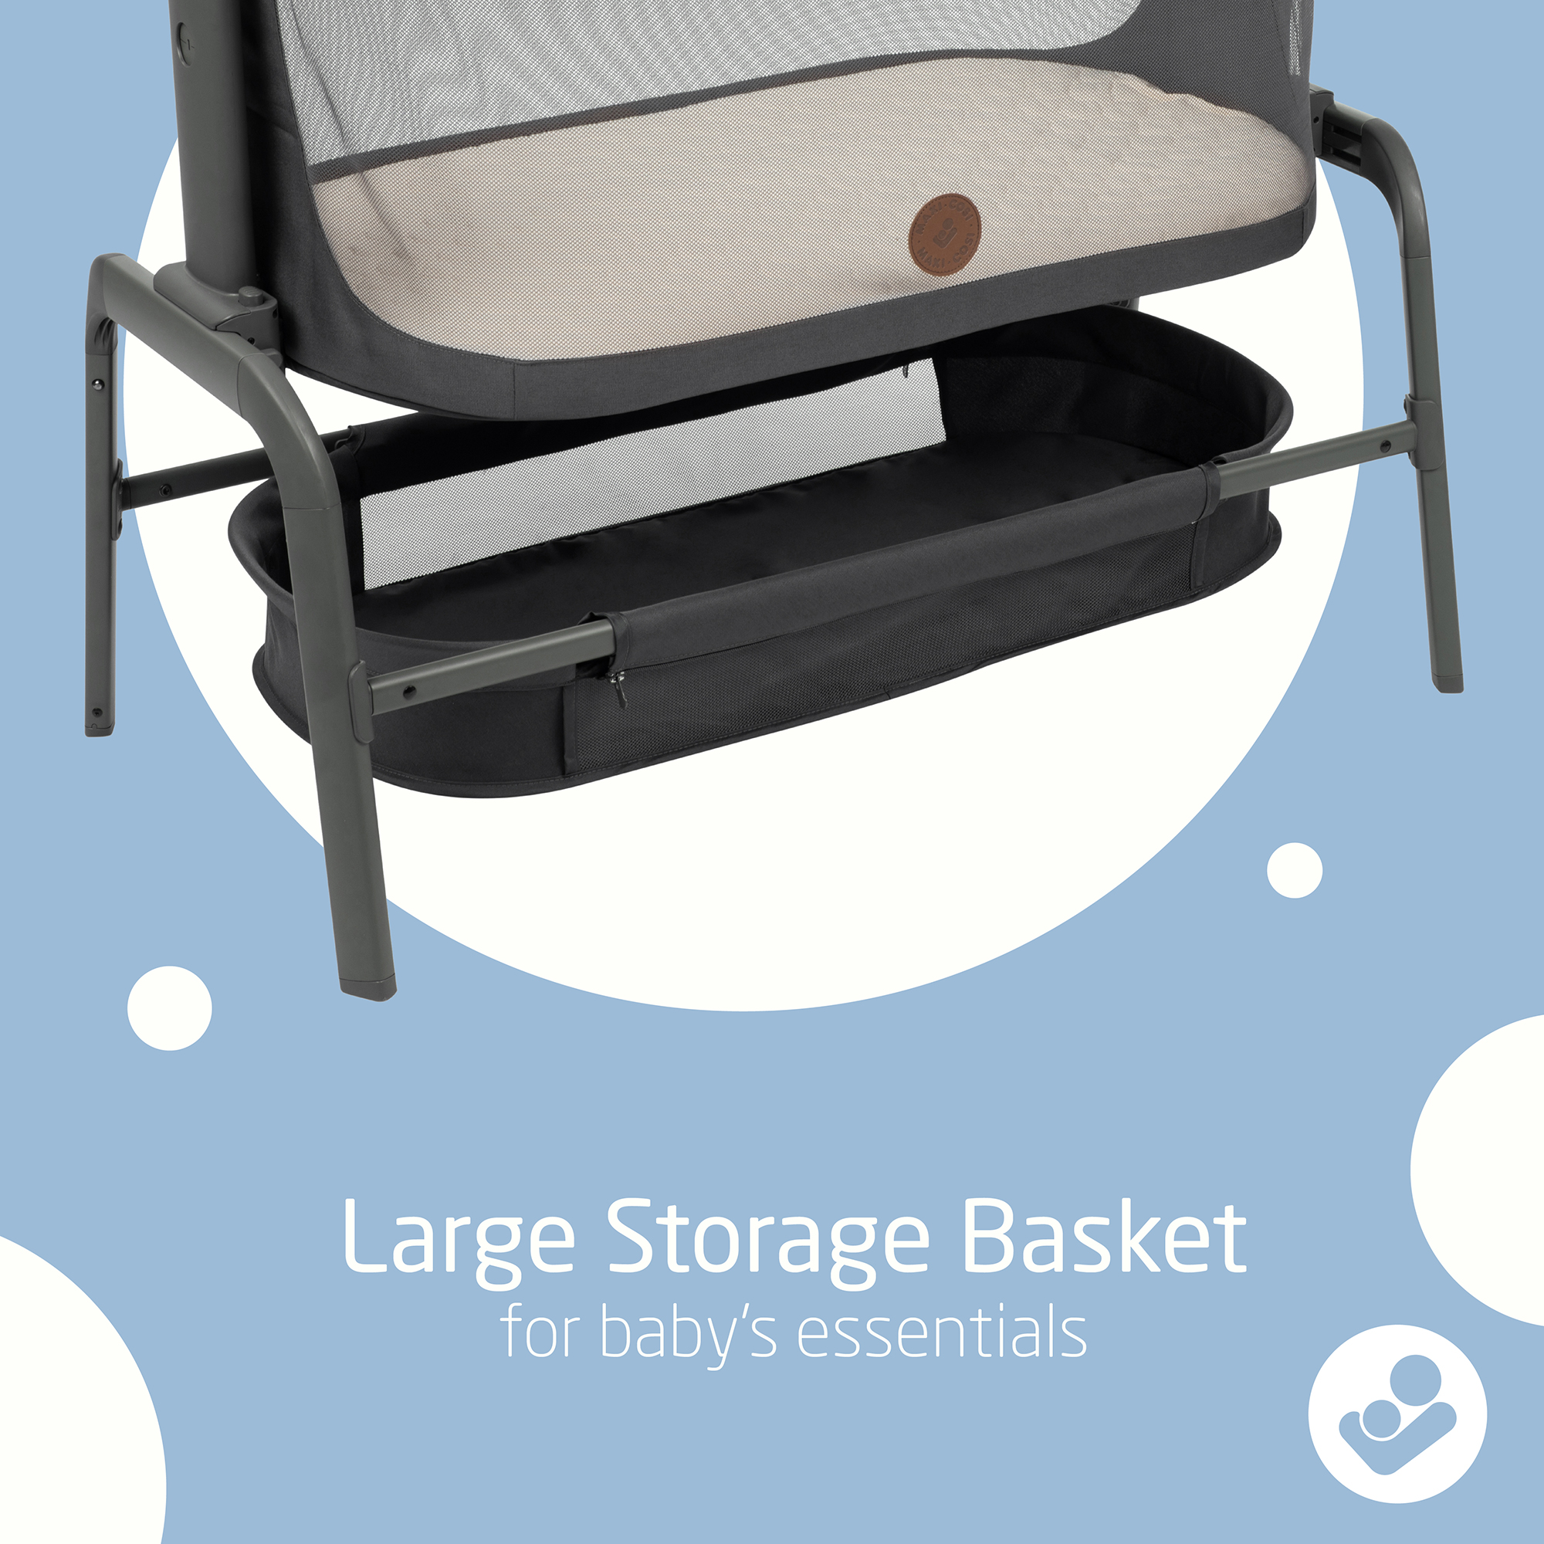
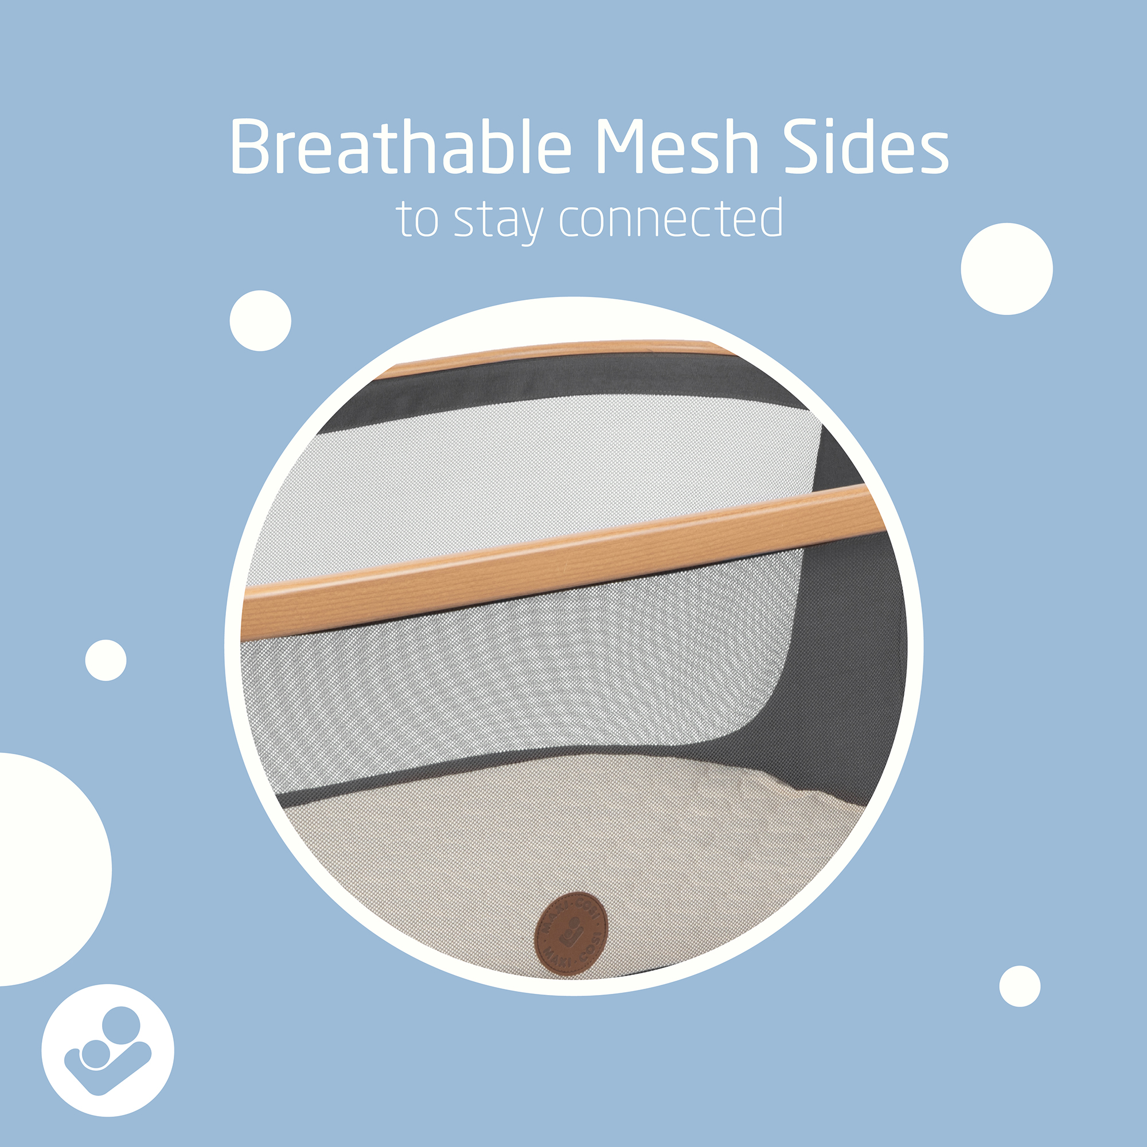
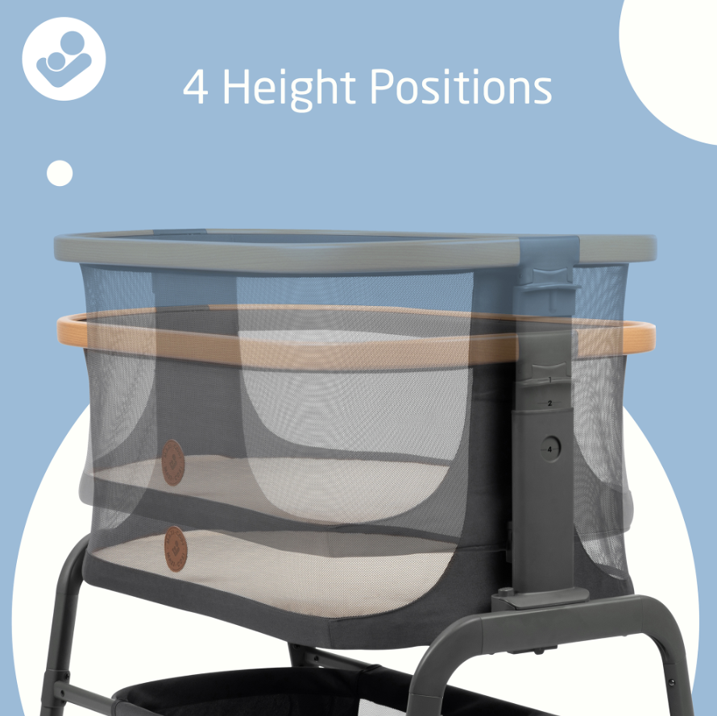
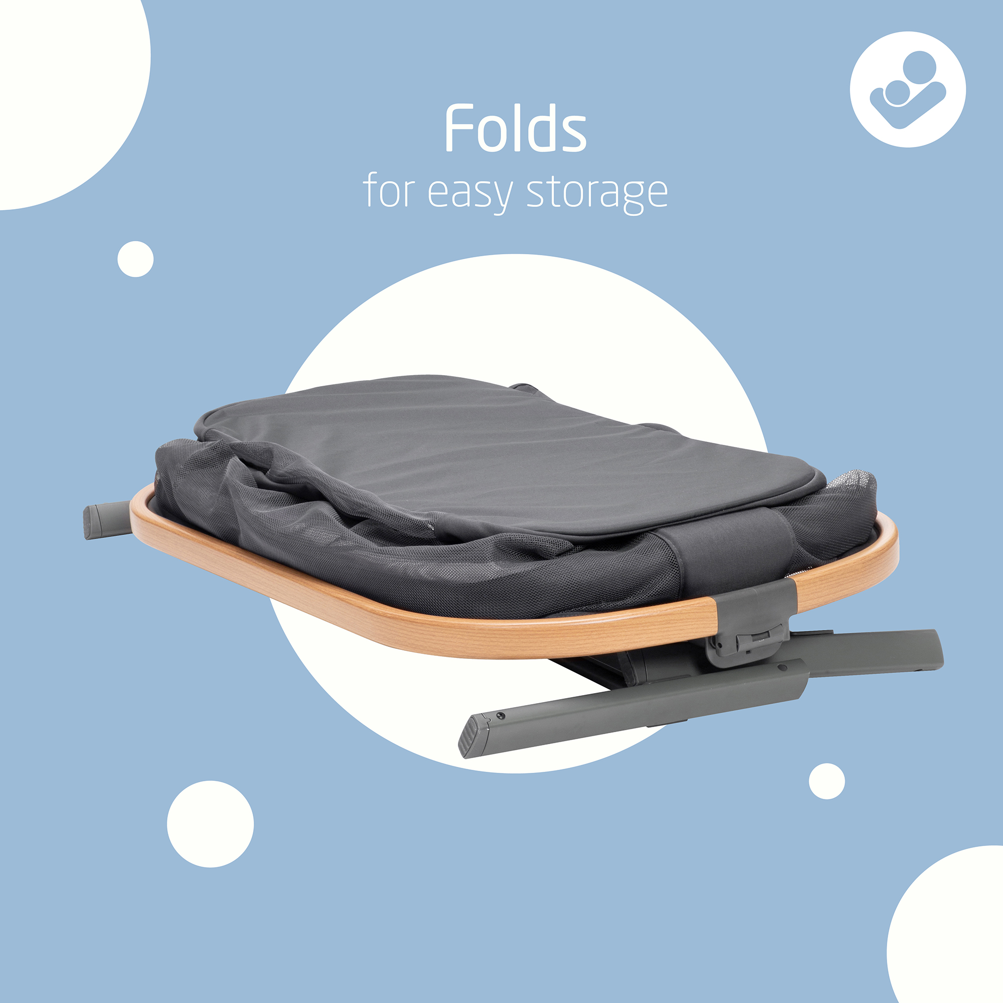
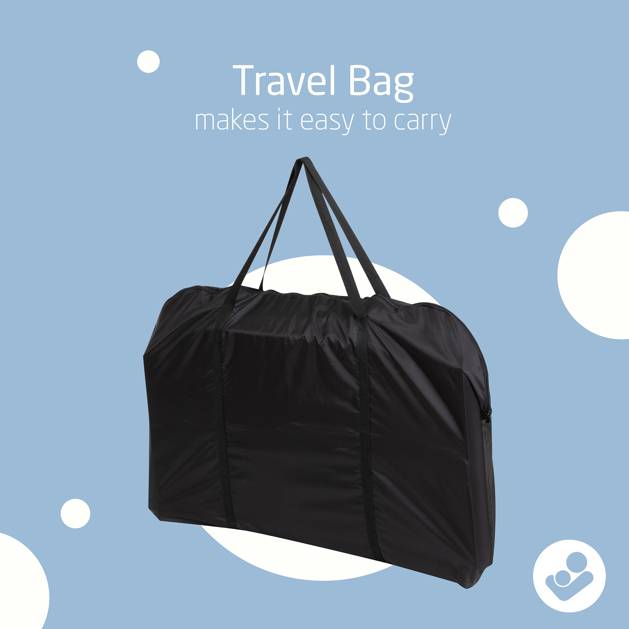
Social carousel
It's here! Introducing the NEW Iora Bedside Bassinet. Putting your little one down for rest time can be tricky, but with the Iora Bassinet, baby can sleep comfortably – all within an arm’s reach. Iora's got:
• 3 slide positions & 4 height positions
• Comfy mattress
• Breathable mesh sides
• Compact fold
• Travel bag
At the end of the day, it's all about comfort. But we're guessing we already had you at sleep.

Slide 3
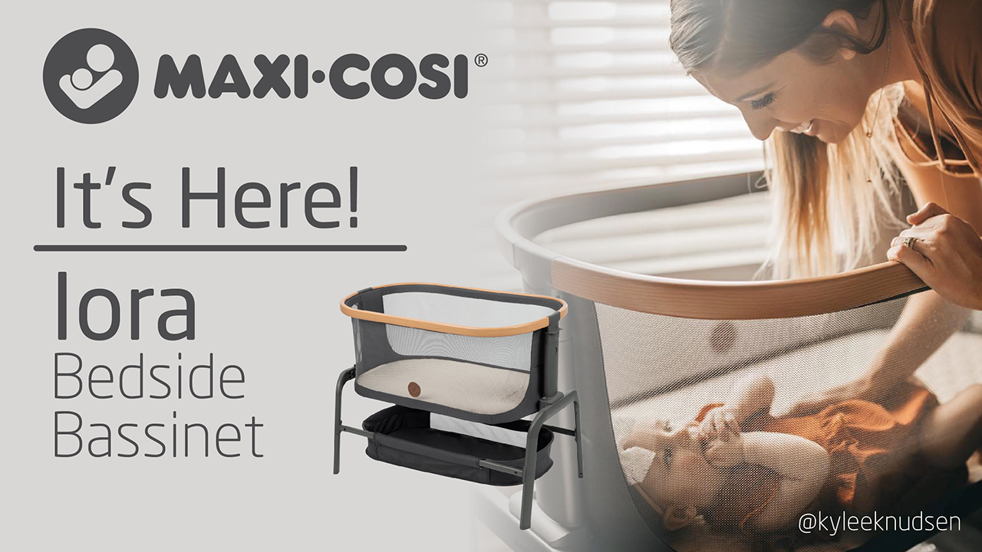
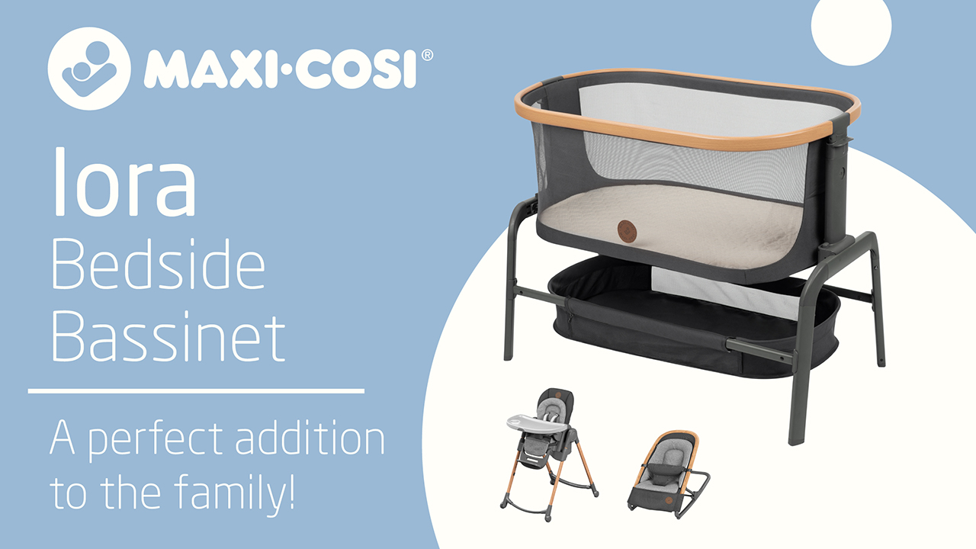
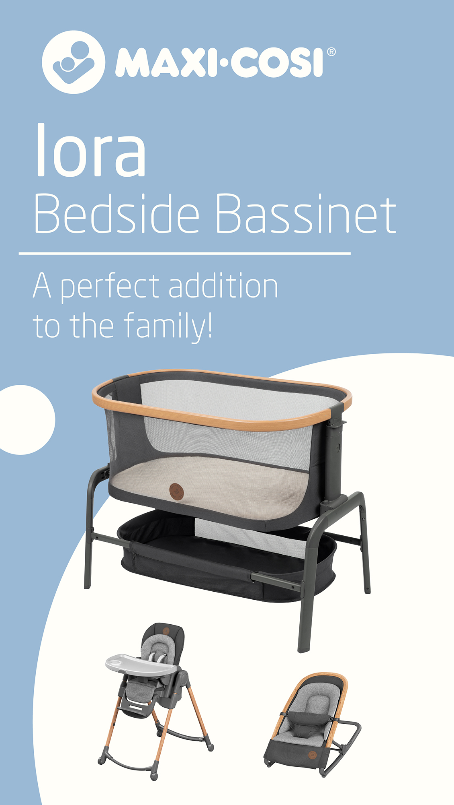

Website banners

Slide 4
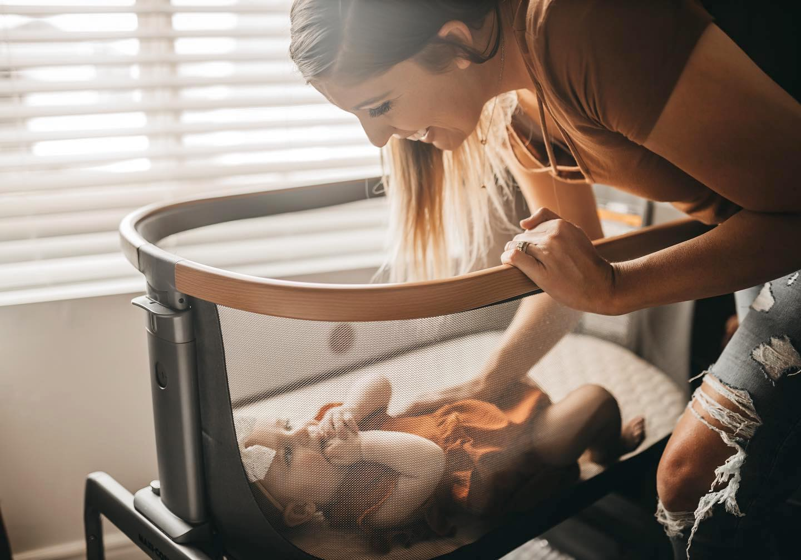
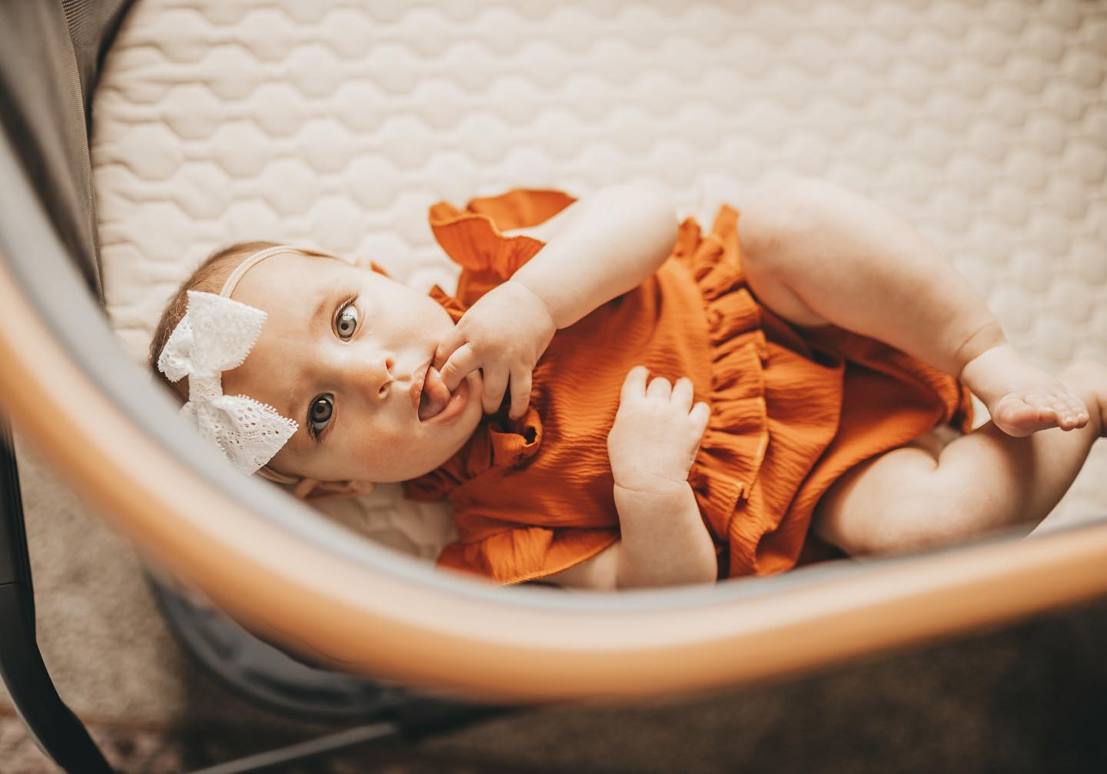
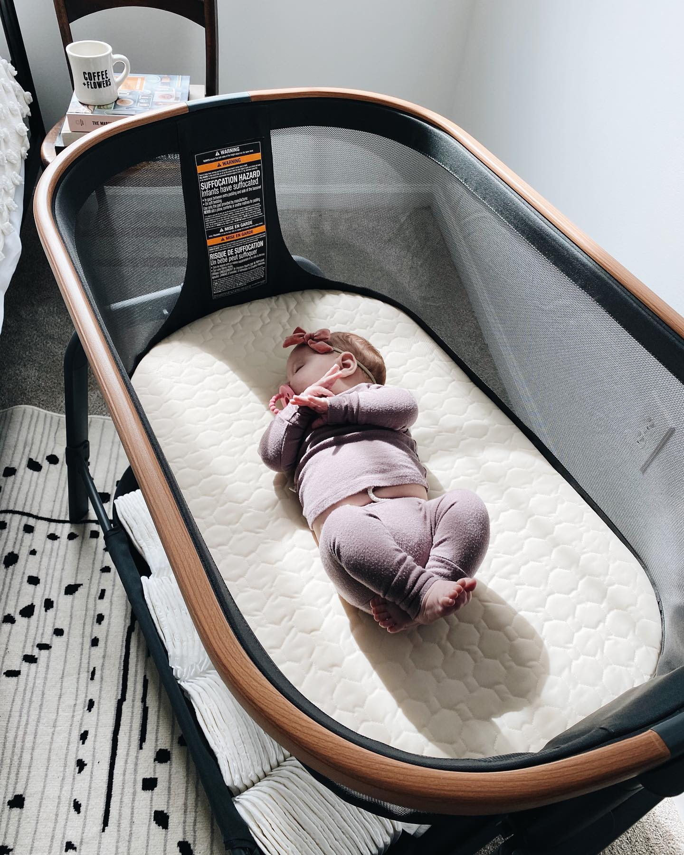
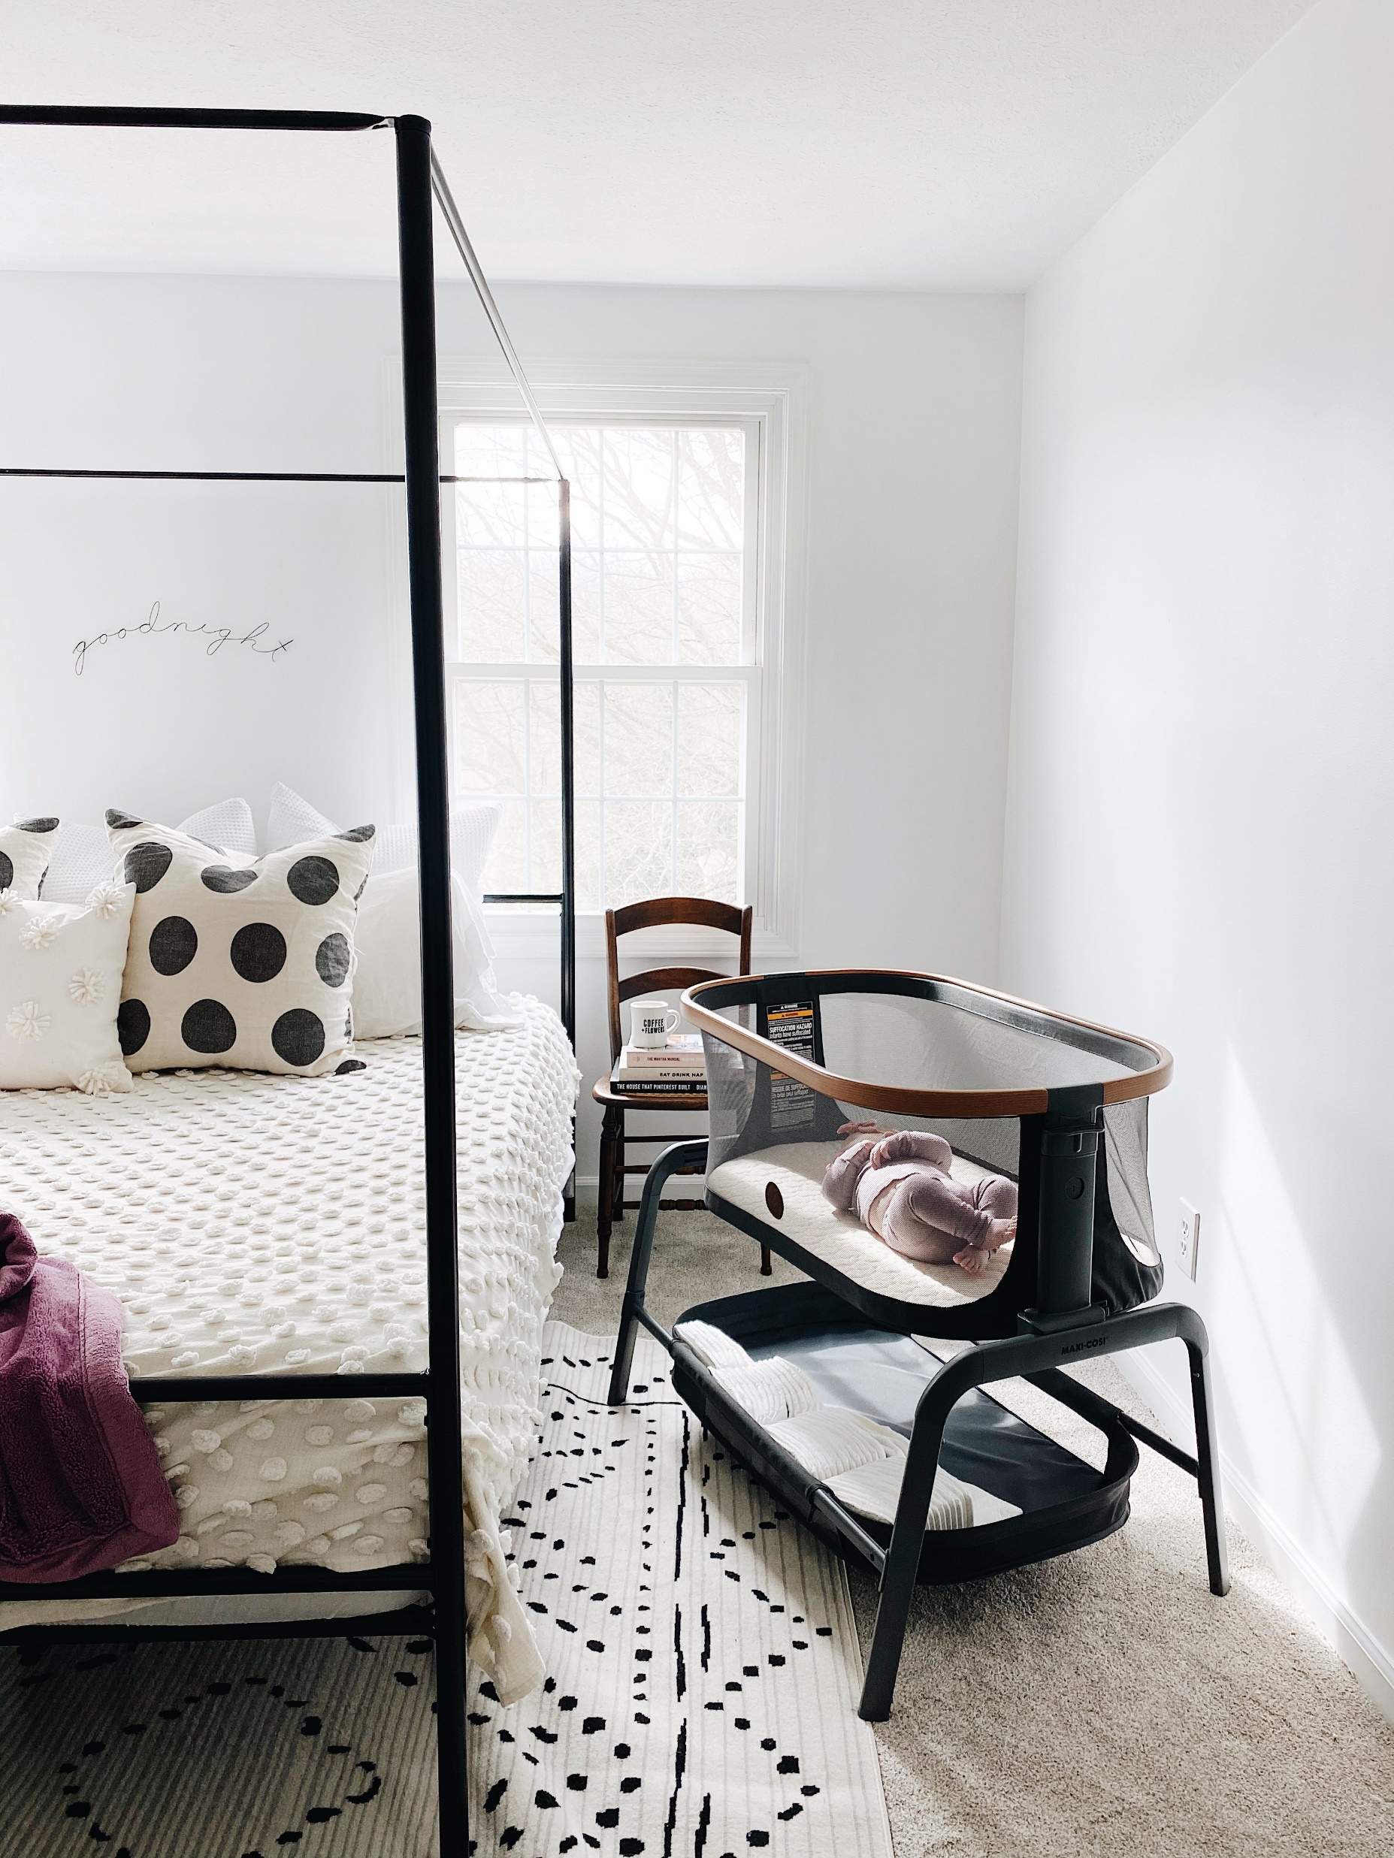
Iora Launch – ****Influencers must be tagged
The best kind of wake-up call 📷: @kyleeknudsen
Sleep tight! Maxi Cosi Iora Bassinet🌙📷: @withloveandkelly
Put baby down to sleep anytime, anywhere, with the Iora Bedside Bassinet. 📷: @withloveandkelly

Slide 5
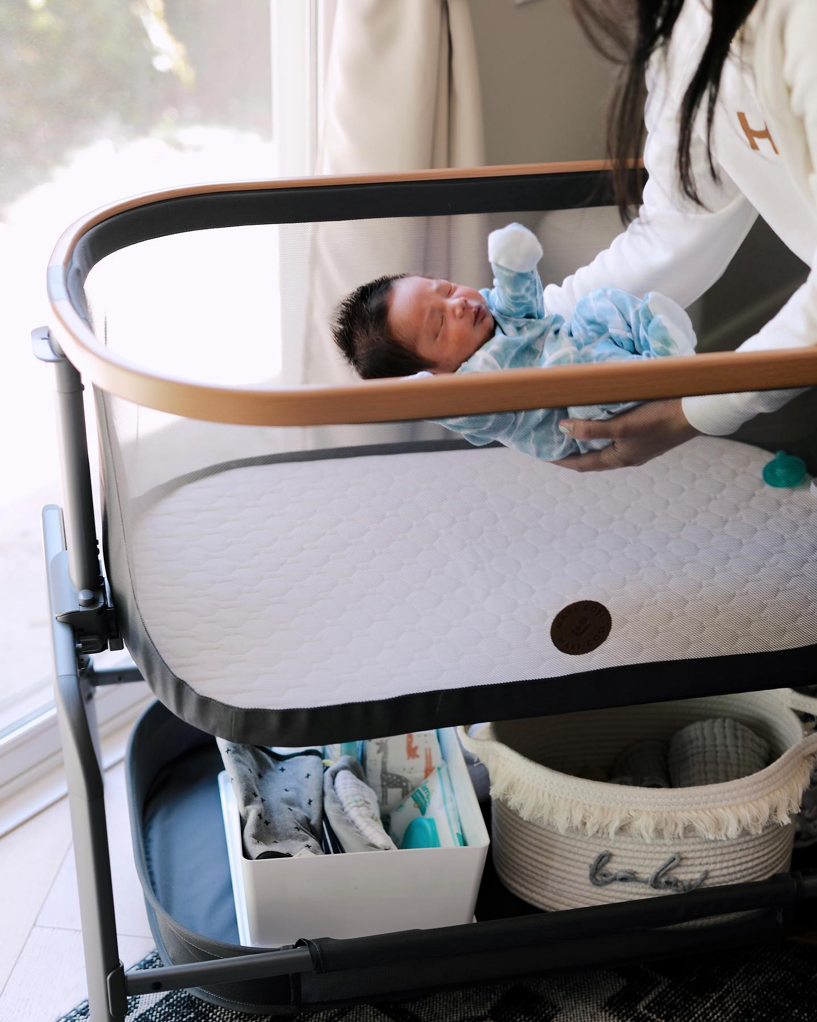
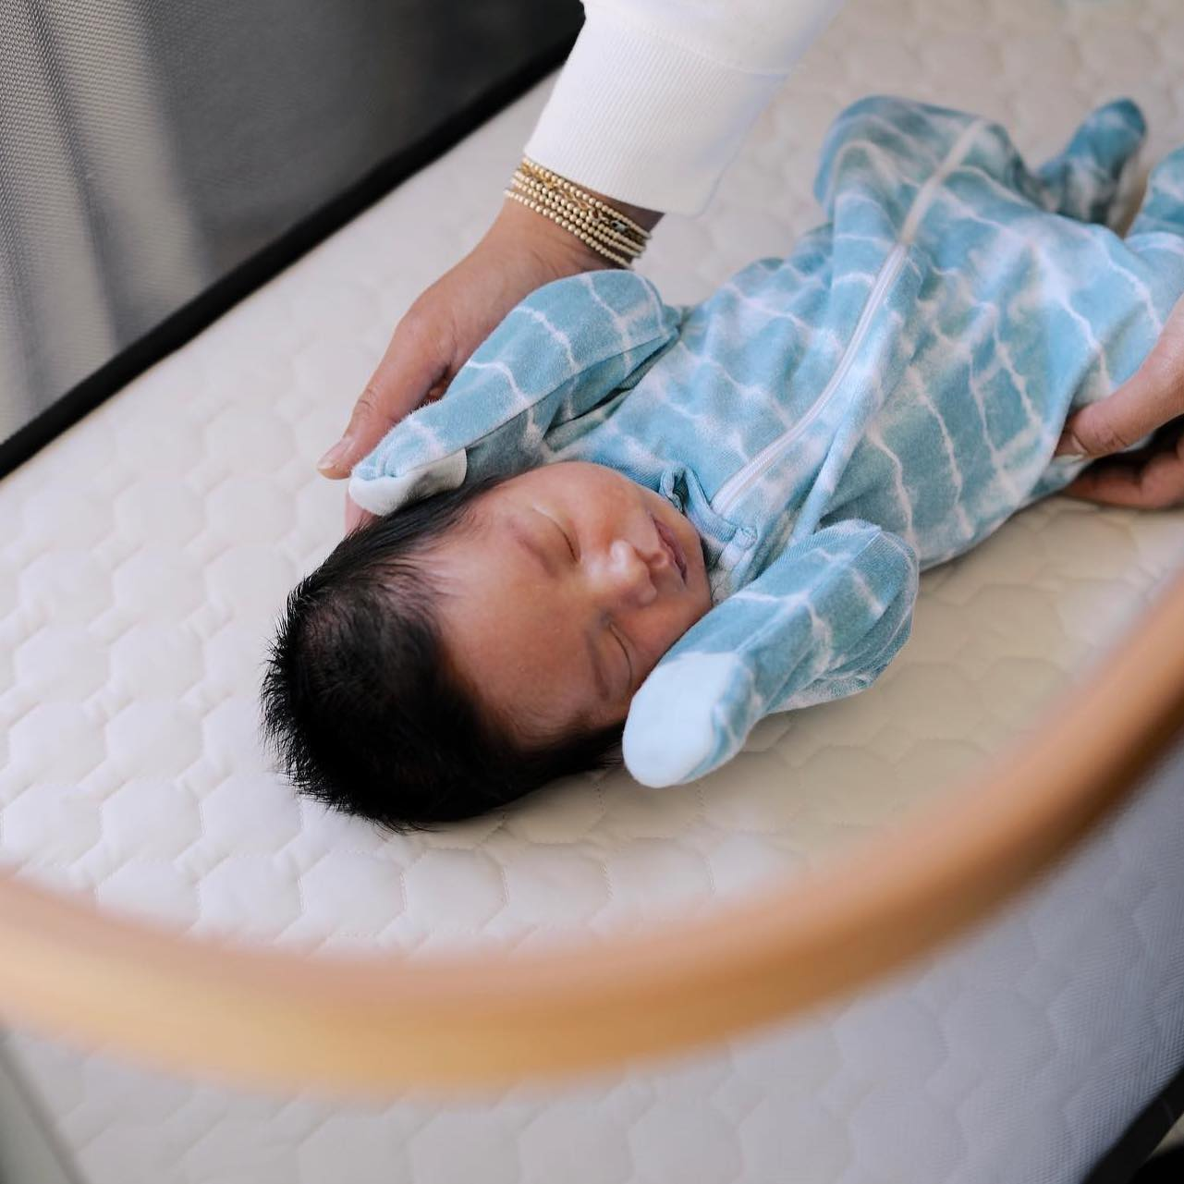
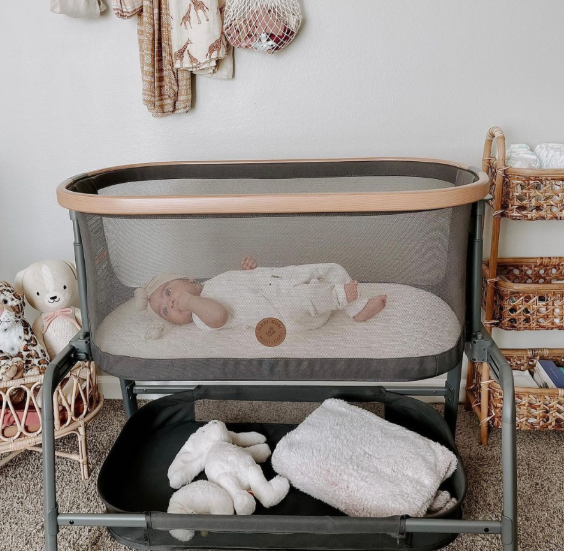
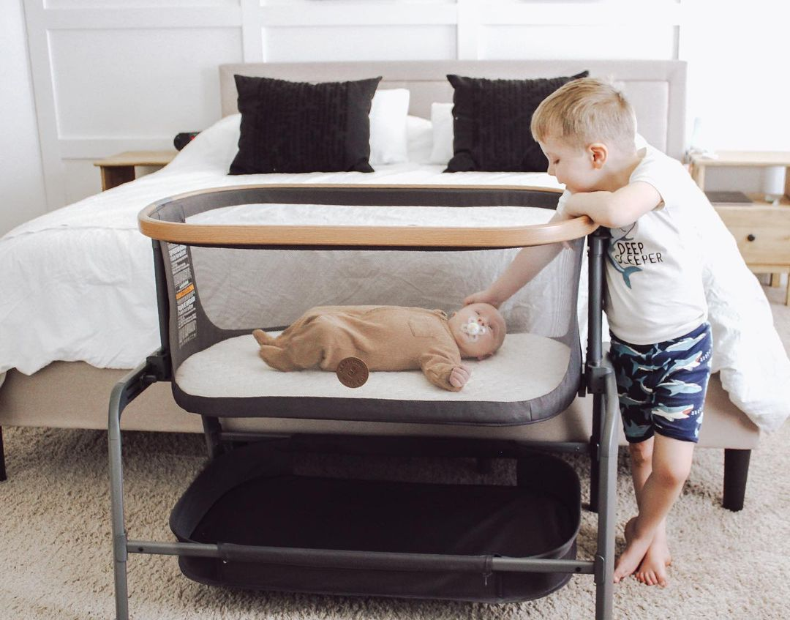
There's a lot to love about the Iora Bedside Bassinet, but that extra-large storage basket for diapers, wipes, blankets and burp cloths might just be our favorite. 📷: @sassandsun
The safest way for baby to sleep is without anything else in the bassinet. Iora comes with a super-soft, machine washable mattress, so baby can sleep soundly, and you can have peace of mind. 🕊️ 📷: @sassandsun
Sweet dreams 🌙 📷: @nicole.marshall
📷: @martis.raya

